Slide 1
HIV
Lydia Zajackowski
Brandon Velasco

Slide 2
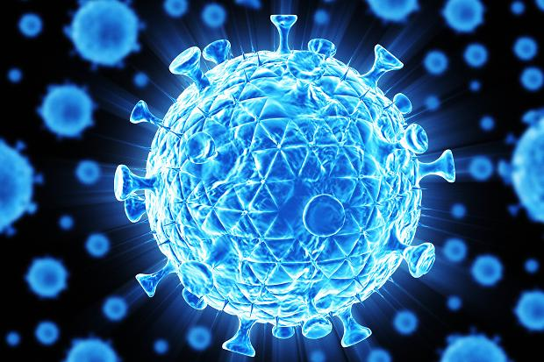
What is HIV?
Notes:
Mayo Clinic Definitions -
HIV - “HIV is a sexually transmitted infection. It can also be spread by contact with infected blood or from mother to child during pregnancy, childbirth or breast-feeding. It can take years before HIV weakens your immune system to the point that you have AIDS.”
H - Human
I - Immunodeficiency
V - Virus
AIDS - “AIDS (acquired immunodeficiency syndrome) is a chronic, potentially life-threatening condition caused by the human immunodeficiency virus (HIV). By damaging your immune system, HIV interferes with your body's ability to fight the organisms that cause disease.”
A - Acquired
I - Immuno
D - Deficiency
S - Syndrome
At the cellular level HIV is a virus. Just like the flu or Rhinovirus.
- The big difference is that the human immune system can’t get rid of the Human Immunodeficiency Virus.
Stages of HIV Infection:
1 - Acute Infection - The virus begins to take over CD4 cells and replicate in the body.
- As a result CD4 count will decrease dramatically.
- Most common symptoms are similar to the flu and present between 2 - 4 weeks after contraction.
- This is response is sometime called, “ Acute Retroviral Syndrome.”
Once an individual has presented with Acute Retroviral Syndrome there is a significant chance of transmission to other individuals.
2. Clinical Latency - “Asymptomatic HIV infection” - During this time the HIV virus is replicating within the infected person, but the individual is no longer presenting with flu like symptoms.
- During this stage the virus can still be transmitted.
- Individuals can remain in this stage for years.
3. Aids - This is the final stage. It is defined by a severally compromised immune system that makes the infected individual susceptible to “opportunistic infections.”
- Once CD4 levels are below 200 cells/mm^3 of blood. You are said to have “progressed Aids.”
- Average life expectancy with progressed Aids is 1 - 3 years.
Treatments:
There is NO CURE for Aids.
There are multiple drugs that can be used to suppress the HIV virus during different stages in replication.
These drugs have shown to increase life expectancy by decades.
- They also have shown to reduce the chance of transmission.

Slide 3
What is going on at the cellular level?
-Receptor Mediated Endocytosis
-CD4 Receptor
-Reverse Transcription (Reverse Transcriptase)
-Makes Proteins for HIV
-Transcription of Virus
-Endocytosis of Virus
-The cycle continues...
Notes:
Trust me guys. The notes won’t make a difference. I can explain it to you guys if you’d like.

Slide 4
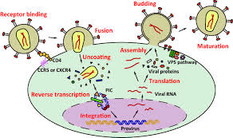
The Life Cycle of HIV
Notes:
When HIV first enters the human blood stream the virus circulates throughout the body. The protective surface of HIV is studded with particular proteins called GP-1 20 and inside is a capsid that contains the viral RNA and viral enzymes. The GP-1 20 protein on the virus is only able to bind to a cell surface protein on the macrophage called the cd4 receptor. A second receptor protein called CCR5 must also be present on the macrophage for the virus to enter the cell by endocytosis. Viral RNAs and enzymes are released into the cell cytoplasm. Reverse transcriptase uses the viral RNAs to synthesize a new strand of viral DNA and then the complementary DNA strand. The new DNA strand then moves to the nucleus of the cell where it integrates into the host cell’s DNA. Transcription of the DNA within the nucleus now results in the production of viral RNAs. This serves as the genome for the virus and can be used as messenger RNAs to produce viral proteins during translation by the ribosomes. Complete viruses are assembled and released from the cell by exocytosis which causes little harm to the macrophage. Eventually after a few years the gene that codes for the GP-1 20 protein is altered by mutation. The altered GP-1 20 protein changes its core receptor allegiance and now binds to a different cell receptor CXCR4 which is found on the surface of T cells. The same processes occur within the T cells. Once these new viruses leave the T-cell they rupture the plasma membrane which kills the cell. As these newly released viruses invade and destroy other T-cells, the body’s immune responses are weakened.

Slide 5
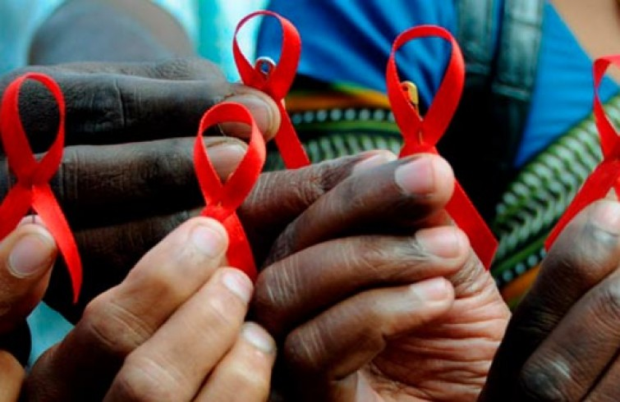
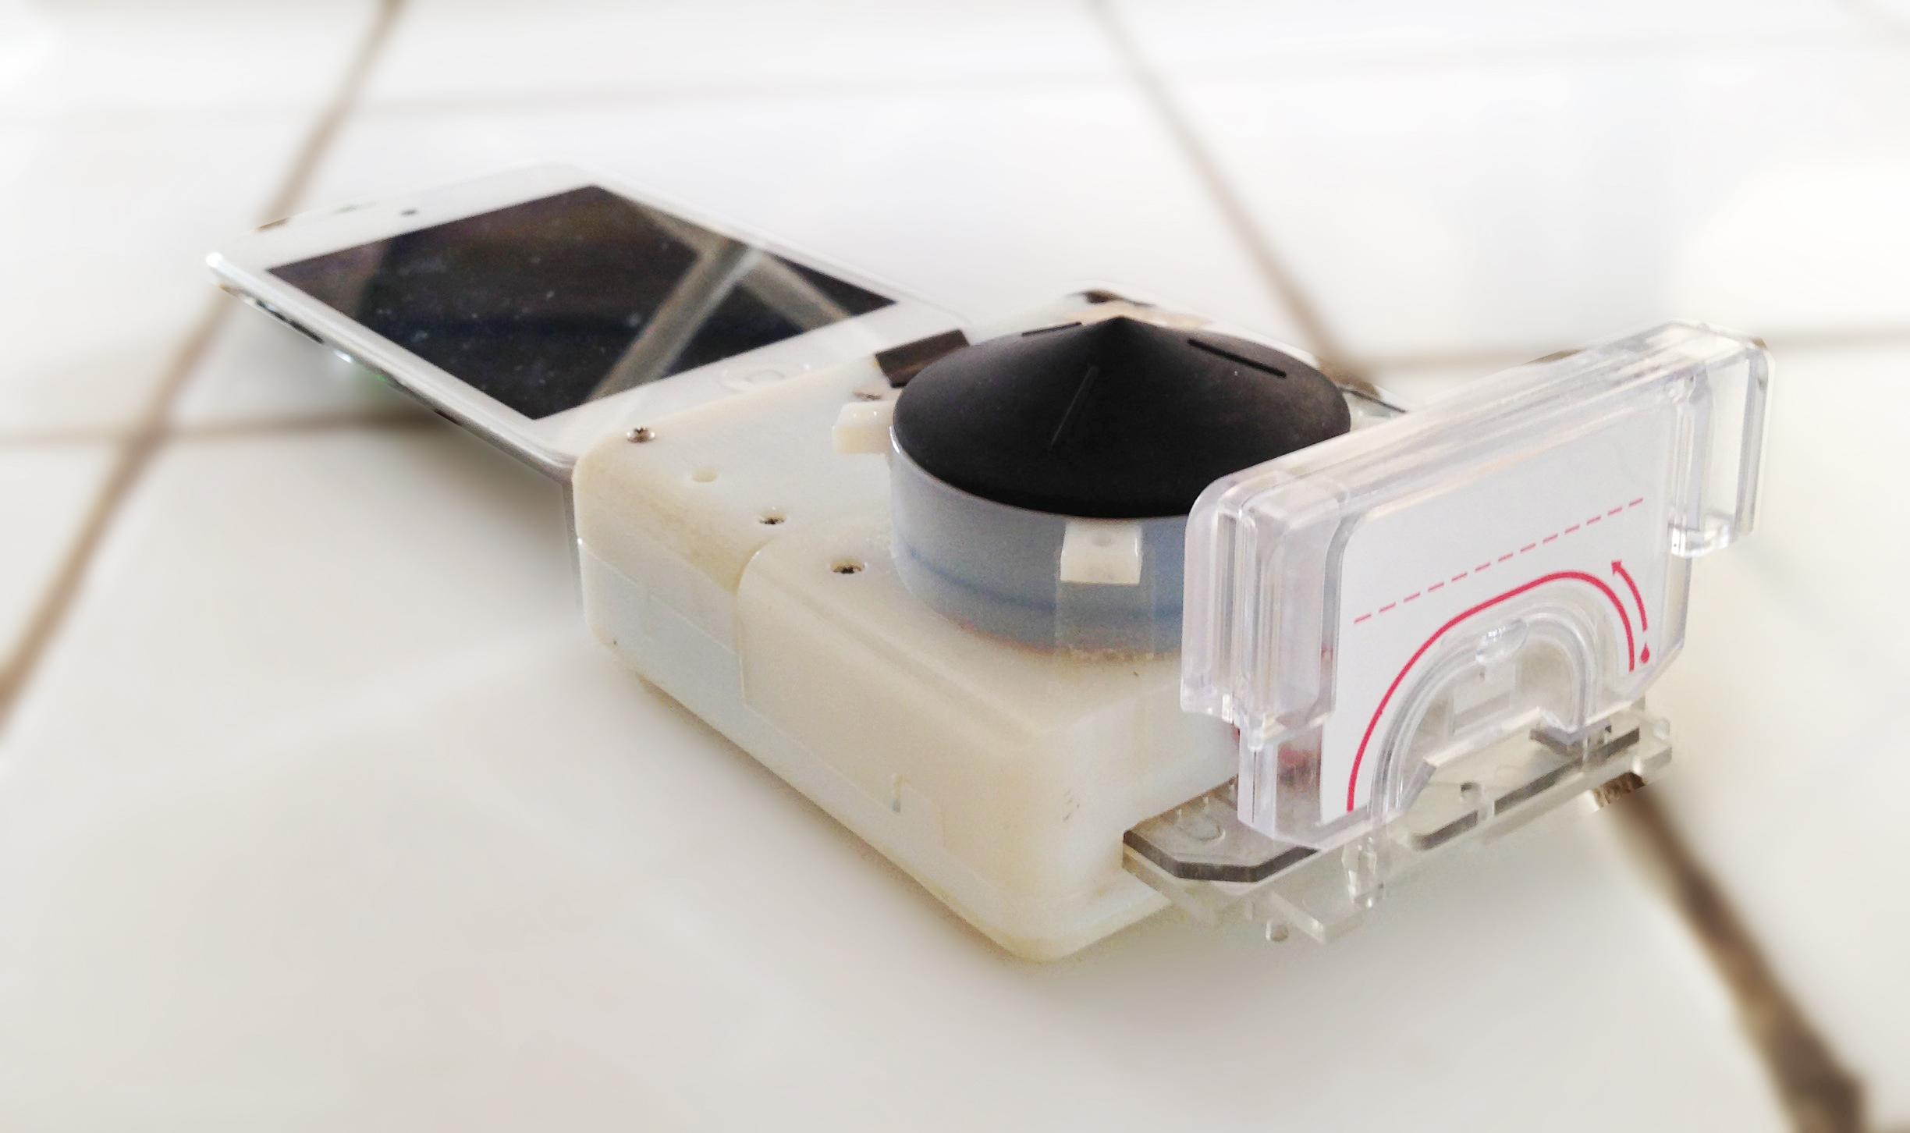
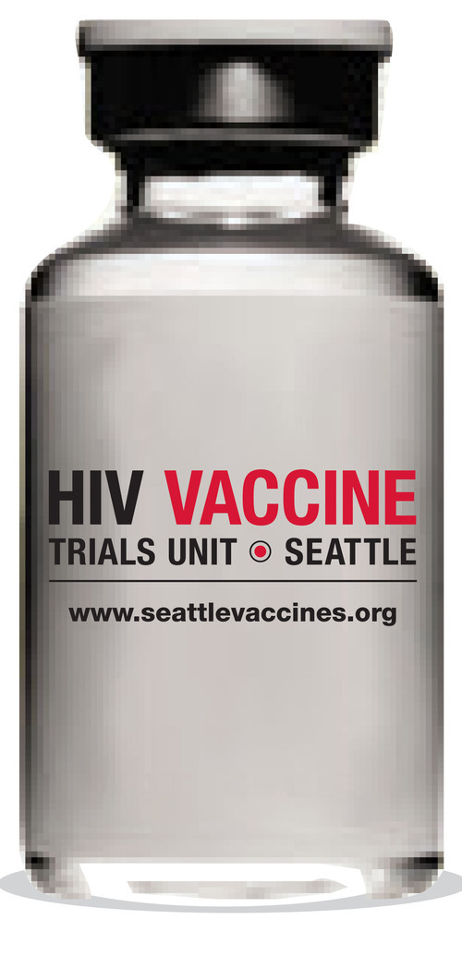
HIV in the news
Notes:
Lydia to draft slides, Josh to present
Cuba
-many Cubans have contracted a ‘circulating recombinant form’
-Cuban strain = CRF19-found to have high levels of immune response molecule(RANTES) that causes the virus to ignore CCR5 entirely by binding it down HIV uses CXCR4(potentially leading to AIDS earlier than usual)
-some researchers have determined to ‘trap’ the virus by hiding aforementioned keys for goodàstrain that dies off on its own w/o gaining access to body’s cells
HIV block(FOX)
-molecule that blocks infection with the virus
-new protein(eCD4-IG) developed blocks points where virus binds to both receptors=no point of entry
-blocks more strains than any of antibodies that disable the virus
HIV smartphone
-Columbia University new attachment to detect HIV and syphilis in one 15 min test
-uses simple optics and fluid control to process finger prick of blood
-more accessibility
-HIV screening is common in all pregnant women(common test)
HIV vaccine trials
-in Seattle collaborates with university of WA
-vaccine to prevent HIV infections
-the study products do not contain the HIV virus therefore cannot cause HIV infection
-also are conducting mucosal studies in women to better understand how women get infected during intercourse

Slide 6
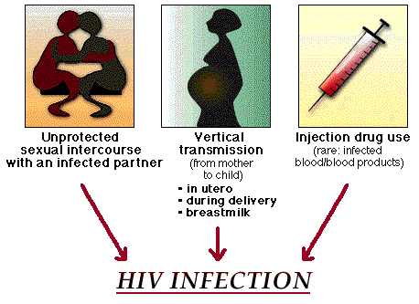
Who gets HIV?
-Sex
-Blood
-Drugs
-Breast Milk
-Bodily Fluids
Notes:
Lydia to work on slide, Josh to present
-Those exposed to HIV infected blood, semen, breast milk and other bodily fluids
-most commonly through sex or sharing drug injection equipment

Slide 7

Anyone can get HIV.

Slide 8
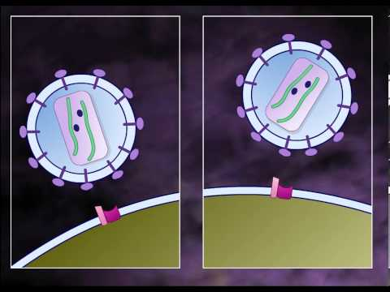
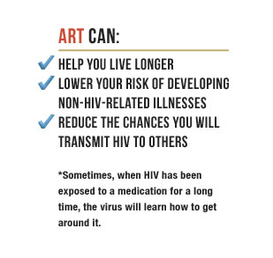
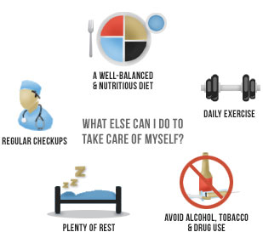
Clinical Situation for HIV Patients
Notes:
Josh to work on slide and present:
-HIV Positive Individuals should seek treatment and regular follow-up care from their providers
-Current Treatment is based on a couple of factors:
--You are experiencing severe symptoms of HIV disease.
--You have an opportunistic infection.
--Your CD4 count is 350 cells/cubic millimeter or less.
--You are pregnant.
--You have HIV-related kidney disease.
-Patients are currently given a “cocktail” drug treatment. These cocktails can include anywhere from 3-5 actual medications: Nucleoside reverse transcriptase inhibitors (NRTIs), Non-nucleoside reverse transcriptase inhibitors (NNRTIs), Protease inhibitors (PIs), Fusion inhibitors, Cellular chemokine receptor (CCR5) antagonists, Integrase inhibitors all with the ultimate goal of keeping T helper Cells (CD4) UP!
-Patients should be treated for other health conditions and opportunistic infections; testing for diabetes, blood pressure, vaccines that are whole killed or peptide vaccines
-GOAL: Keep T cell count up high, keep viral load low

Slide 9

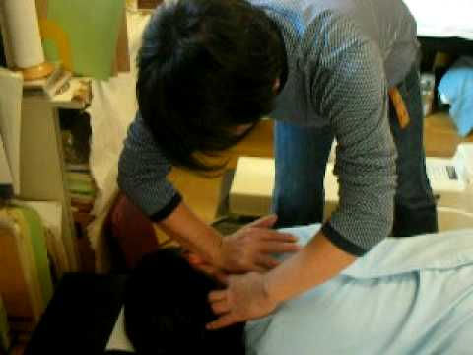
How Chiro can help?
Upper Cervical adjustments
Notes:
Joe to find resources, Josh to present
Using specific upper cervical adjustments may boost the immune system and restore CD4 cell count in patients with HIV.
A study was done using chiropractic treatment on two groups whom had HIV and the positive effects that resulted.
The group that received chiropractic treatment found a 48% increase in CD4 cell count compared to the control group that didn’t
These results were taken after a six month period

Slide 10
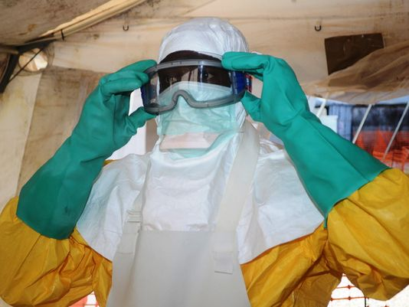
Limiting your exposure risk:
Notes:
Reduce your risk of exposure to bodily fluids (of HIV Positive People or otherwise)
Routine Testing
Pre-exposure Prophylaxis for high risk individuals
Talk about it.

Slide 11
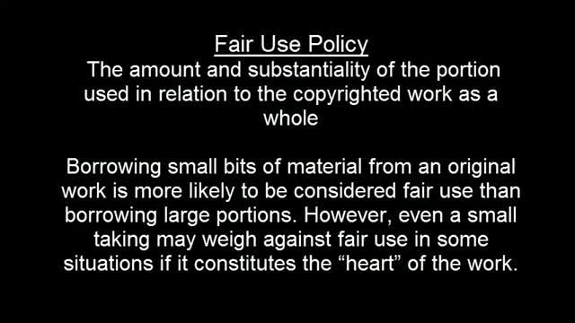

Slide 12
Question 1:
What cells are affected by the HIV virus?

Slide 13
Question 1:
Helper T cells
Bonus!
What type of receptor is affected by the HIV virus?

Slide 14
Bonus Answers!!!!
If you said CD4 receptors, then congratulations!!! You have managed to pay attention!!!

Slide 15
Question 2:
True or False:
HIV and AIDs are the same thing.

Slide 16
Question 2:
False:
HIV and AIDs are the same thing.

Slide 17
Question 3:
Which of these do not limit the transmission of HIV?
Talking about it
Male Circumcision
Condom Use
Treatment
None of the above

Slide 18
Question 3:
Which of these do not limit the transmission of HIV?
Talking about it
Male Circumcision
Condom Use
Treatment
None of the above

Slide 19
Citations / Sources
CDC
Nature World News
GigaOm
FoxNews
Medical Express
Seattlevaccines.org
Medscape
AIDS.gov AIDS.gov II
AIDS.gov III
Mayo Clinic
YouTube
Howard Hughes Medical Institute

Slide 20
Sources/Citations
-http://www.cdc.gov/hiv
-http://www.foxnews.com/health/2015/02/18/molecule-shows-ability-to-block-hiv/
-http://www.natureworldnews.com/articles/12848/20150219/mega-aggressive-hiv-strain-attacking-cuba.htm
-https://gigaom.com/2015/02/22/engineers-have-created-a-smartphone-hiv-test-that-costs-35-to-make/
-http://medicalxpress.com/news/2015-02-scientists-anti-hiv-agent-powerful-vaccine.html
-http://www.seattlevaccines.org
http://emedicine.medscape.com/article/211316-medication
https://www.aids.gov/hiv-aids-basics/just-diagnosed-with-hiv-aids/treatment-options/reasons-to-start-treatment/index.html
http://www.mayoclinic.org/diseases-conditions/hiv-aids/basics/definition/con-20013732
https://www.aids.gov/hiv-aids-basics/hiv-aids-101/what-is-hiv-aids/
https://www.aids.gov/hiv-aids-basics/just-diagnosed-with-hiv-aids/hiv-in-your-body/hiv-lifecycle/
https://www.youtube.com/watch?v=D0lpvbPg5B4
http://www.hhmi.org/biointeractive/hiv-life-cycle
Notes:
Please update this with the URL, and I will clean it up

